Slide 1
Mood Detect Chih Wei Tung, Shanshan Zhao, Weixuan Jiang, Zhonghao Guo Team #2
Github Link: https://github.com/tungchihwei/EC601-Mood-Detect
Trello Link: https://trello.com/b/QZmTZ7UV/ec-601-final-project
Notes:
1

Slide 2

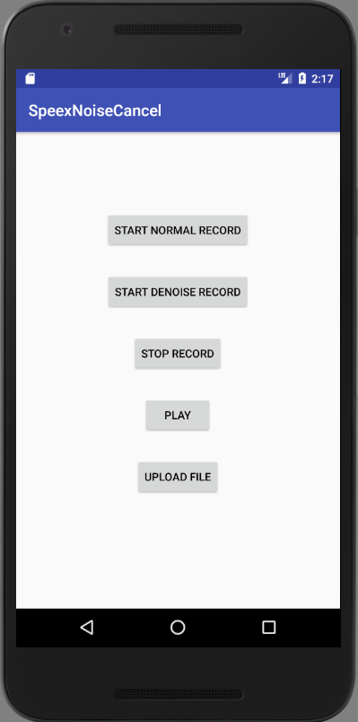
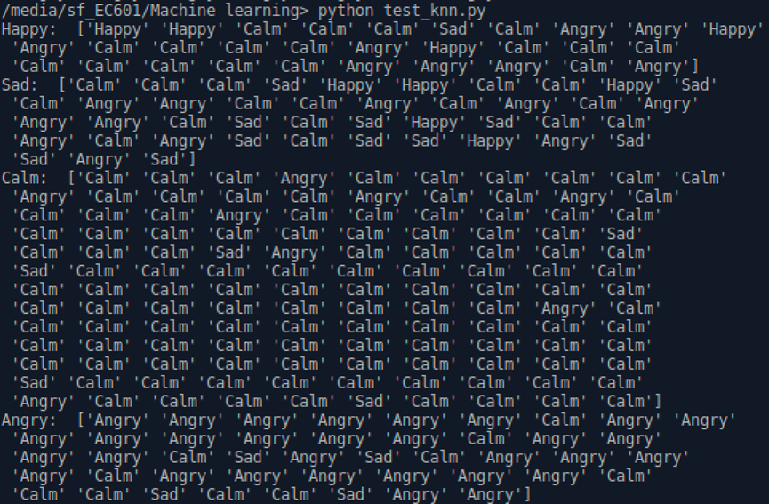
Demonstration
*
Happy: error rate(19/30) accuracy rate36.7%
Sad : error rate(25/43) accuracy rate41.8%
Calm : error rate(13/130) accuracy rate90%
Angry : error rate(11/45) accuracy rate75.5%
2

Slide 3
Demonstration
*
demo
3

Slide 4
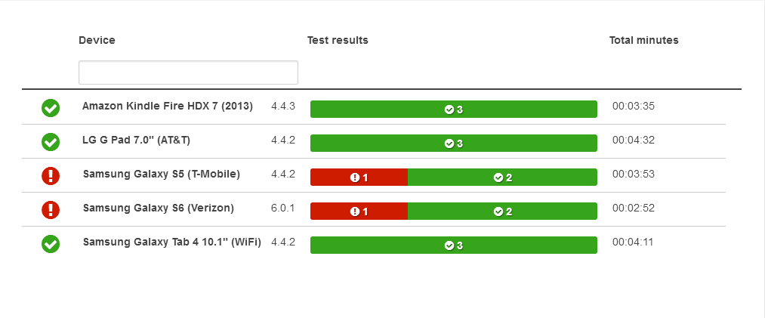
Unitest
*
13passed 2failed
4

Slide 5
Challenges
*
We haven’t test the “login” function successfully since the tomcat server
encouters some problem.
The accuracy rates of “happy” and “sad” are not as we expected.
5
Notes:
This is the sample we gonna use in data training and prediction.
The file was cut to small pieces. Later, we will extract their features and put them into machines learning parts.

Slide 6
*
Thank you
6
Notes:
This is the sample we gonna use in data training and prediction.
The file was cut to small pieces. Later, we will extract their features and put them into machines learning parts.

